Slide 1
2-mer Features of TF E2F1 Interaction with Specific Binding Sites Project Update
Sunwoo Yim
Gordan Lab, Duke Center for Genomic and Computational Biology

Slide 2
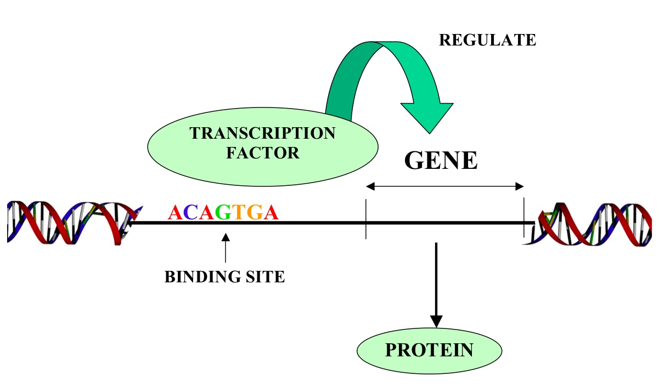
Transcription Factor E2F1

Slide 3
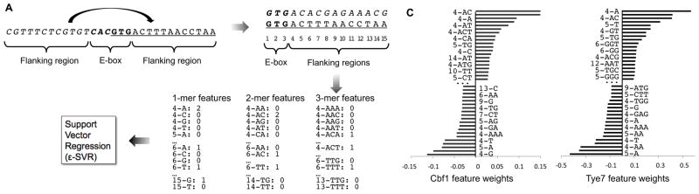
Formatting
Scaling
Training
Predicting
Select
Convert
Parameters

Slide 4
Bibliography
Gordân, Raluca et al. “Genomic Regions Flanking E-Box Binding Sites Influence DNA Binding Specificity of bHLH Transcription Factors through DNA Shape.” Cell reports 3.4 (2013): 1093–104. Web. 4 Mar. 2015.
https://sbi4u2013.files.wordpress.com/2013/02/transcript.jpg

Slide 5
Questions?

